Slide 1
Title: Study on Application of Bayesian Networks and SEER Database in the Predicting of Non-Small Cell Lung Cancer
Team Member: Wei Chen, Chinedu
Dec. 12, 2017

Slide 2
Introduction of the study
For accurate medical diagnosis and prediction, it is often necessary to model a patient's condition over time. Because there is great uncertainty in clinical medicine, a system for diagnostic or prognostic evaluation must be able to represent and reason with uncertainty.

Slide 3
Bayesian Network (BN) models are a class of machine learning models with some unique characteristics that make them suitable for medical applications.
A Bayesian network has been used as a useful tool to create individualized predictive models due to its several attractive characteristics, which have led to various studies successfully in the field of oncology.

Slide 4
Lung cancer is a leading cause of cancer death worldwide. Of all lung cancer cases, non-small cell lung cancer (NSCLC) accounts approximately for 83%. The incidence of NSCLC was 40.60/100,000, and 5-year survival rate was only 22.1%. For treating patients with advanced and inoperable stage, a combination of chemotherapy and radiotherapy is mainly used instead of surgical resection .

Slide 5
However, patients with locally advanced NSCLC following radiotherapy suffer from a high local failure rate. Despite many efforts to improve treatment outcomes, a low two-year local control rate as low as 27% in these patients requires innovative diagnostic and prognostic models to improve early detection of tumor local failure.

Slide 6
The database of Surveillance, Epidemiology and End Results (SEER) was set up by National Cancer Institute (NCI) in 1973. It is one of the world's recognized data sources following up for cancer patients. Providing reliable data support for clinical research.

Slide 7
The present study will use the SEER database to extract the NSCLC cases of Asian; adopt relationship and applicability of better machine learning methods to build Asian people NSCLC prognosis model and prediction assessment system, and provide decision support for the treatment and prognosis of clinicians.

Slide 8
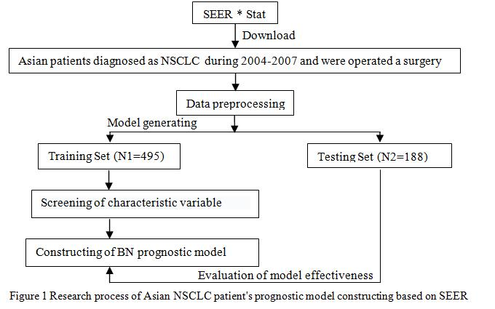
CONSTRUCTION PLAN OF TUMOR PROGNOSTIC MODEL

Slide 9
Data download
The data of “Incidence-SEER18 Regs Research Data+Hurricane Katrina Impacted Louisiana Cases, Nov2014” was invoked by the STEER*Stat software. The release date of this version was at the end of 2012; NSCLC patient's data was downloaded based on the morphological coding of ICD-O-3 malignant tumor.

Slide 10
Basis for the selection of variable
According what mentioned in the American Joint Committee on Cancer (AJCC), the National Comprehensive Cancer Network (NCCN) , and Collaborative Stage Manual Online Help (CS), related to the patient's prognostic factors, all fields containing the above variables were extracted from SEER*Stat and registered at the time of the first diagnosis. The information was organized to lead in tables.

Slide 11
Screening of characteristic variable
To determine whether the variables are independent in the patient's survival, SPSS22.0 software was first applied to analyze the training samples with One-Way ANOVA (t test), and then Logistic regression analysis was used to analyze the variables obtained by single factor analysis. Screening NSCLC high correlation prognostic factors, P<0.05 was statistically significant. The adjustment variables are incorporated into the final model in combination with the recommendations of clinicians.

Slide 12
Construction of tumor prognostic model
Supervised learning method in machine learning was selected to the tumor prognosis prediction model. R Studio software was applied to establish bayesian survival prediction model and to complete the structure adjustment of BN, as well to construct an effective prognostic model.

Slide 13
Evaluation of model effectiveness
The data mining software WEKA was selected to compare the predicting accuracy, accuracy and area under the curve of ROC among models of BN and other three common classified.

Slide 14
PROCESSING
A. Construction of tumor prognostic model
B. Comparison experiment
C. Experimental analysis

Slide 15
A. Construction of tumor prognostic model
Research object: Asian patients diagnosed with NSCLC since 2004 were selected as the final study subjects, which included the patient’s death of NSCLC within 5 years, and patients who had been followed up for 5 years and still survived. The total number was 683.

Slide 16
Research variables: Seventeen prognostic variables were extracted from SEER, as can be seen in Table 1, the last four are continuous variables, and the others are categorical variables.

Slide 17
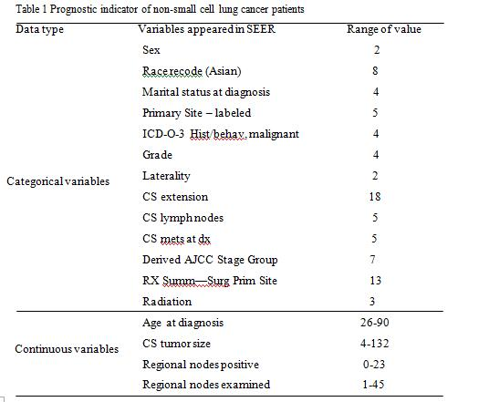

Slide 18
Outcome variable: The five-year survival of NSCLC patients is an important index to evaluate the prognostic effect, and was treated as the dependent variable. One month is made as one survival period unit, and the conversion of the classification variables, Patients who lived for 60 months or more were considered "living" (marked 1), otherwise considered "death" (marked 0).

Slide 19
Feature variables selection: In order to reduce the prognostic variables, and improve the prediction accuracy of the model, it is required to carry out high correlation prognostic factors. After One-Way ANOVA analysis, the initial inclusion variables were (P<0.05): age at the time of diagnosis, CS tumor size, histological grade, tumor staging, CS extension , CS lymph nodes, regional nodes positive, marital status, race recode, CS mets at dx, operation type, and whether radiotherapy.

Slide 20
Based on One-Way ANOVA analysis and Logistic regression analysis, the prognostic variables were selected as follow (P<0.05): age at diagnosis, tumor size, histological grade, tumor staging, Regional nodes examined, Regional nodes positive. The results are shown in table 2.

Slide 21
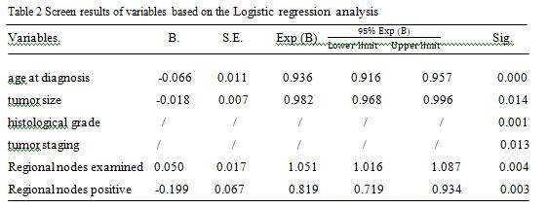

Slide 22
Data preprocessing: Interval method was selected for metric data to discretize the serious deleted data, false record, and patient's information of deaths from non-lung cancer. The discretization method aimed to divide the interval [X₀, X_{N- 1}] into the same subinterval of size D and the suggestion of discretization was given according to the sub-interval index, the observation index i and the discrete level j satisfy the following conditions

Slide 23

The above data preprocessing step is realized by calling bnlearn's function package in software R Studio. Then the data is divided into training set (N1=495) and test set (N2=188) according to the proportion of about 70% and 30%. The training set is used for network learning and adjustment, thus constructing the prognostic model and measuring. The test set is used to evaluate the performance of the model.

Slide 24
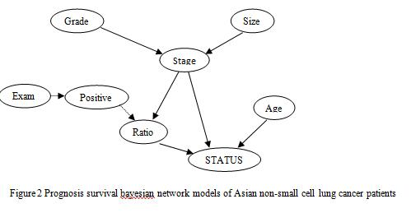
Construction and prediction of the prognostic model

Slide 25

Bayesian Network (BN) describes the dependent relation of child nodes and the parent nodes by means of the nodes representing the variables and the lines representing the relationships between variables , known random variable X = {X1, X2,... Xn}, the distribution of joint probability is above. Among them, Pa (Xi) is a subset of Xi parent nodes, and Xi is independent of its non-linear node variables in network graph

Slide 26
The Bayesian prognostic model constructed by Makond et al. was not studied based on the data obtained, but was established by doctors' opinion.
The survival model of patients is actually based on empirical modeling. The present study can overcome the disadvantages of single modeling with practical experience; combine the network learning methods with patient's prognosis, and doctor's advice to set up patient's prognosis model.
This BN model will be modified and optimized by the R Studio. The network model is shown in Figure 2.

Slide 27
In this study, 188 samples were collected, and 137 were correctly predicted. The prediction accuracy reached 72.87%, as shown in Table 3 and Table 4

Slide 28
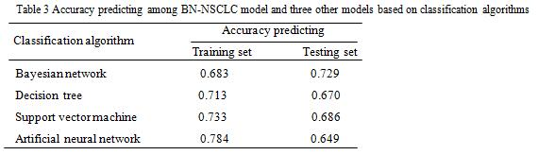
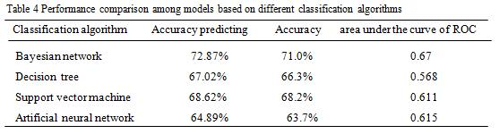

Slide 29
B. Comparison experiment
The decision tree, support vector machine and artificial neural network method are used to establish the prognostic model, and compared the prediction results with prognostic model, which is set up at this study.

Slide 30
In WEKA, the corresponding method of J48, SMO and Multilayer Perceptron are selected to establish the prognostic model and the parameter acquiescence.
The prediction accuracy and model performance evaluation of 4 machine learning algorithms are shown in table 3 and table 4.

Slide 31
C. Experimental analysis
The study found that the NSCLC prognosis model constructed by Bayesian network was optimal.

Slide 32
Table 3 showed that although the decision tree, support vector machine (SVM), and artificial neural network in the predictive accuracy of the training set was higher than that of Bayesian network,
but in the testing set three prediction accuracy were significantly reduced in the value compared to the training set, failed to adapt to the new data very well.
It is indicated that they were not suitable for practical application, the model of Bayesian networks is better than the other three models in fitting degree.

Slide 33
Table 4 also showed that the data in predicting accuracy, accuracy and area under ROC curve of Bayesian network model is significantly higher than that of the other three machine learning algorithms.

Slide 34
CONCLUSION
In this study, the survival prognosis model of patients with non-small cell lung cancer patients was established, and the prediction accuracy was 72.87%.
By constructing a Bayesian network to explore the relationship between the prognostic variables and the impact on the survival situation, and on the basis of the internal network structure adjustment combined with clinical expert advice, the relationship between nodes in the model was better explained.

Slide 35
Apply the SEER database in Asia cancer for first time as the main research object to build its prediction model, and playing a supplementary role on the judgment of the prognosis of patients with postoperative five years.
In future research, the inclusion of external validation of other sources can be considered, and the adaptation degree of prediction model itself can be improved and better serve for clinical treatment and prognostic evaluation.

Slide 36
Thanks for your patience!

